Slide 1
Diabetes prediction using EDA
By: Aditya Hasteer Sharma

Slide 2
Description
We were given a dataset, which included medical information related to diabetes.
The features included :
Glucose levels
Insulin levels
BMI
Age
And a little more. Our target variable is Diabetes status.

Slide 3
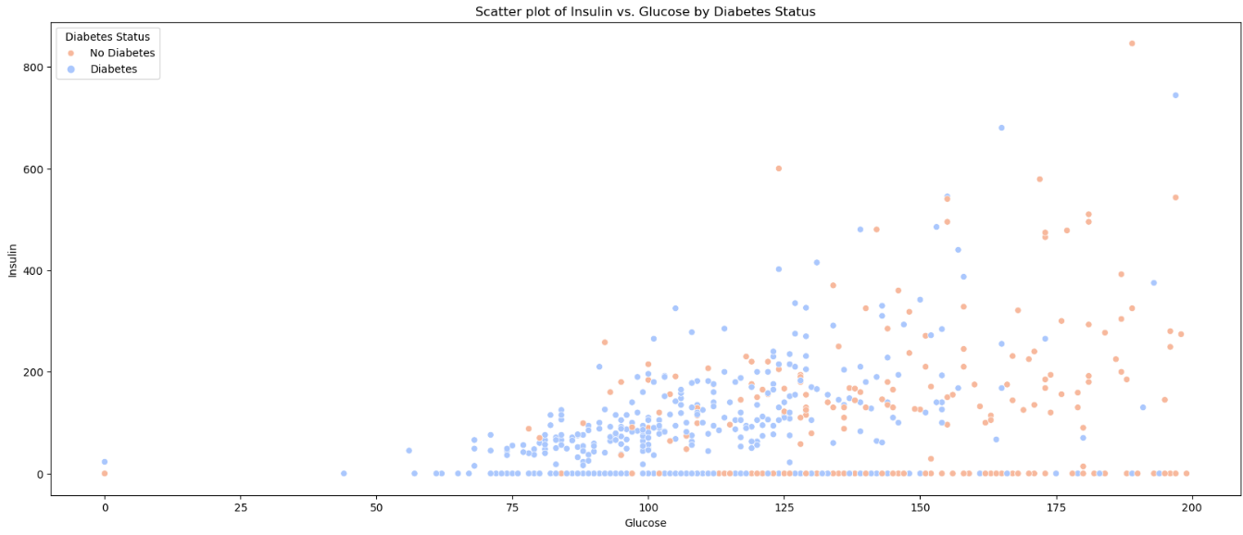
Visualizations
Scatter plot:

Slide 4
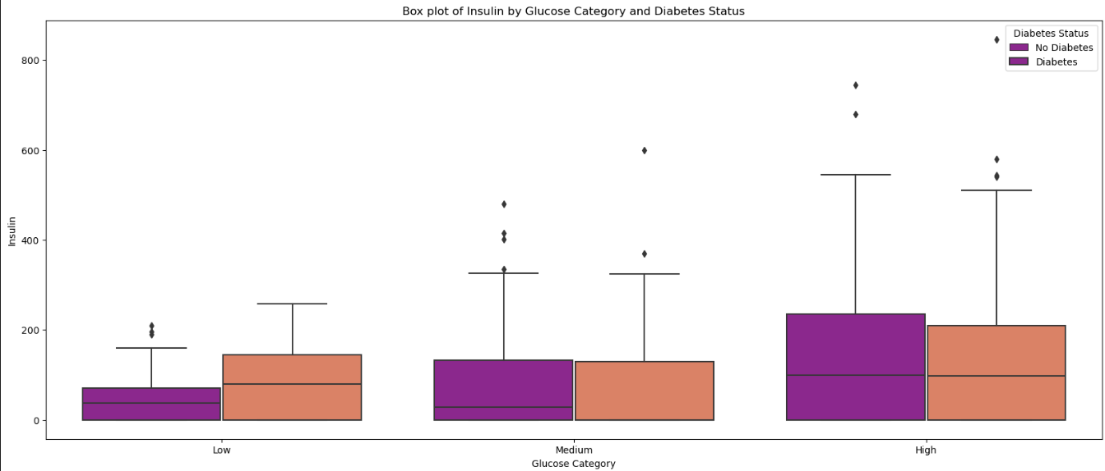
Box plot:

Slide 5
My main purpose to compare glucose and insulin levels is to make accurate predictions about diabetes. In the graphs, you can see how insulin levels vary with respect to glucose levels. If the glucose level is higher than the insulin level, than the person is diabetic. In the graphs, there are clear separations between diabetic and non-diabetic individuals.
Glucose levels are higher in diabetic people than insulin levels.

Slide 6
THANK YOU
Thank you for reviewing my analysis.

